Slide 1
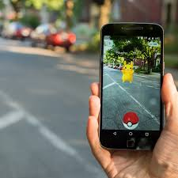
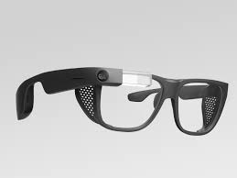
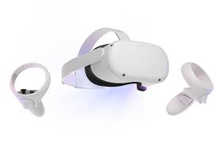
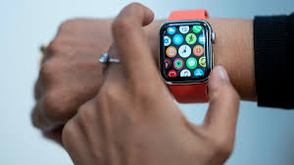
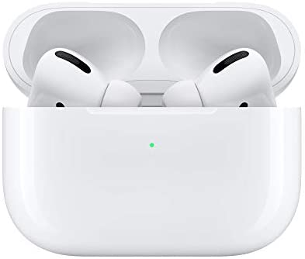
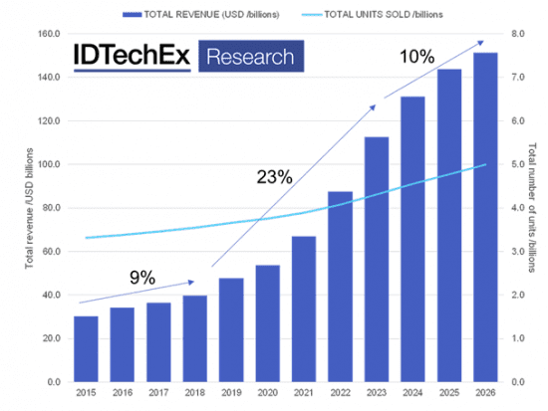
The Future of Wearable Devices
The next big invention
Future and Impact of wearable devices
The future of wearable devices can adapt if computers adapt. Wearable devices are an outcome of computers. They are used as an accessory to the computer, so as the computer adapts the future of wearable devices are basically endless. The Impact of wearable devices might be just like that of computers. According to researchers, they have predicted that wearable devices will be the second best-selling consumer electronic device in the world. That is an impact. So far, we have seen a few inventions that have made an impact. These inventions are VR and AR, which are primarily used for gaming. Other inventions are like wireless heart monitors for patients that need to monitor themselves frequently.
John James, Maoting Zeng, Daniel Munoz, and Jada McRae
THE FUTURE OF WEARABLE DEVICES IS BRIGHT.
Computer Organization Section A
Introduction
Wearable devices are electronic accessories that are designed to be worn by the consumer. Most of the time wearable devices work in collaboration with another device. For example, air pods are a wearable device commonly used with iPhones. Air pods allow you to listen to music with it being completely wireless.
History and Development
Wearable devices started as early as the 1600s with the introduction of the first wearable computer. Development continued throughout the years with inventions such as the calculator watch, wireless webcam, and other devices. Wearable devices really saw its advancement in the 2010s as technology began to advance. Google launched its prototype for smart glasses. Although it was deemed unsuccessful, wearable devices continue to advance and develop.
Conclusion
Wearable devices have been seen to be the one of the most prominent inventions of our lifetime. Wearable devices has only scratched the surface of its possibilities. As computers grow and advance so will wearable devices. The impact that computers have to our future is also because of people using wearable devices. In the last generation, people had to adapt to computers, but in this generation, people will have to adapt to wearable devices.
Wearable devices in gaming
When thinking of wearable devices in gaming the first thing that comes to mind is VR or virtual reality. VR is a simulated experience that places the user in an environment that allows lifelike interactions and perceptions. Another use of wearable devices in gaming would be with Augmented reality. Augmented reality is like virtual reality, but it is different in some ways. Augmented reality uses google glass or other devices to see a virtual object on the real world. For example, the popular game Pokémon Go was created with this technology.

